Slide 1


Data-Intensive Computing with MapReduce
Session 1: Introduction to MapReduce
Jimmy Lin
University of Maryland
Thursday, January 24, 2013
This work is licensed under a Creative Commons Attribution-Noncommercial-Share Alike 3.0 United States See http://creativecommons.org/licenses/by-nc-sa/3.0/us/ for details

Slide 2
What is this course about?
Computing on “big data”
Focus on applications and algorithm design
MapReduce… and beyond

Slide 3
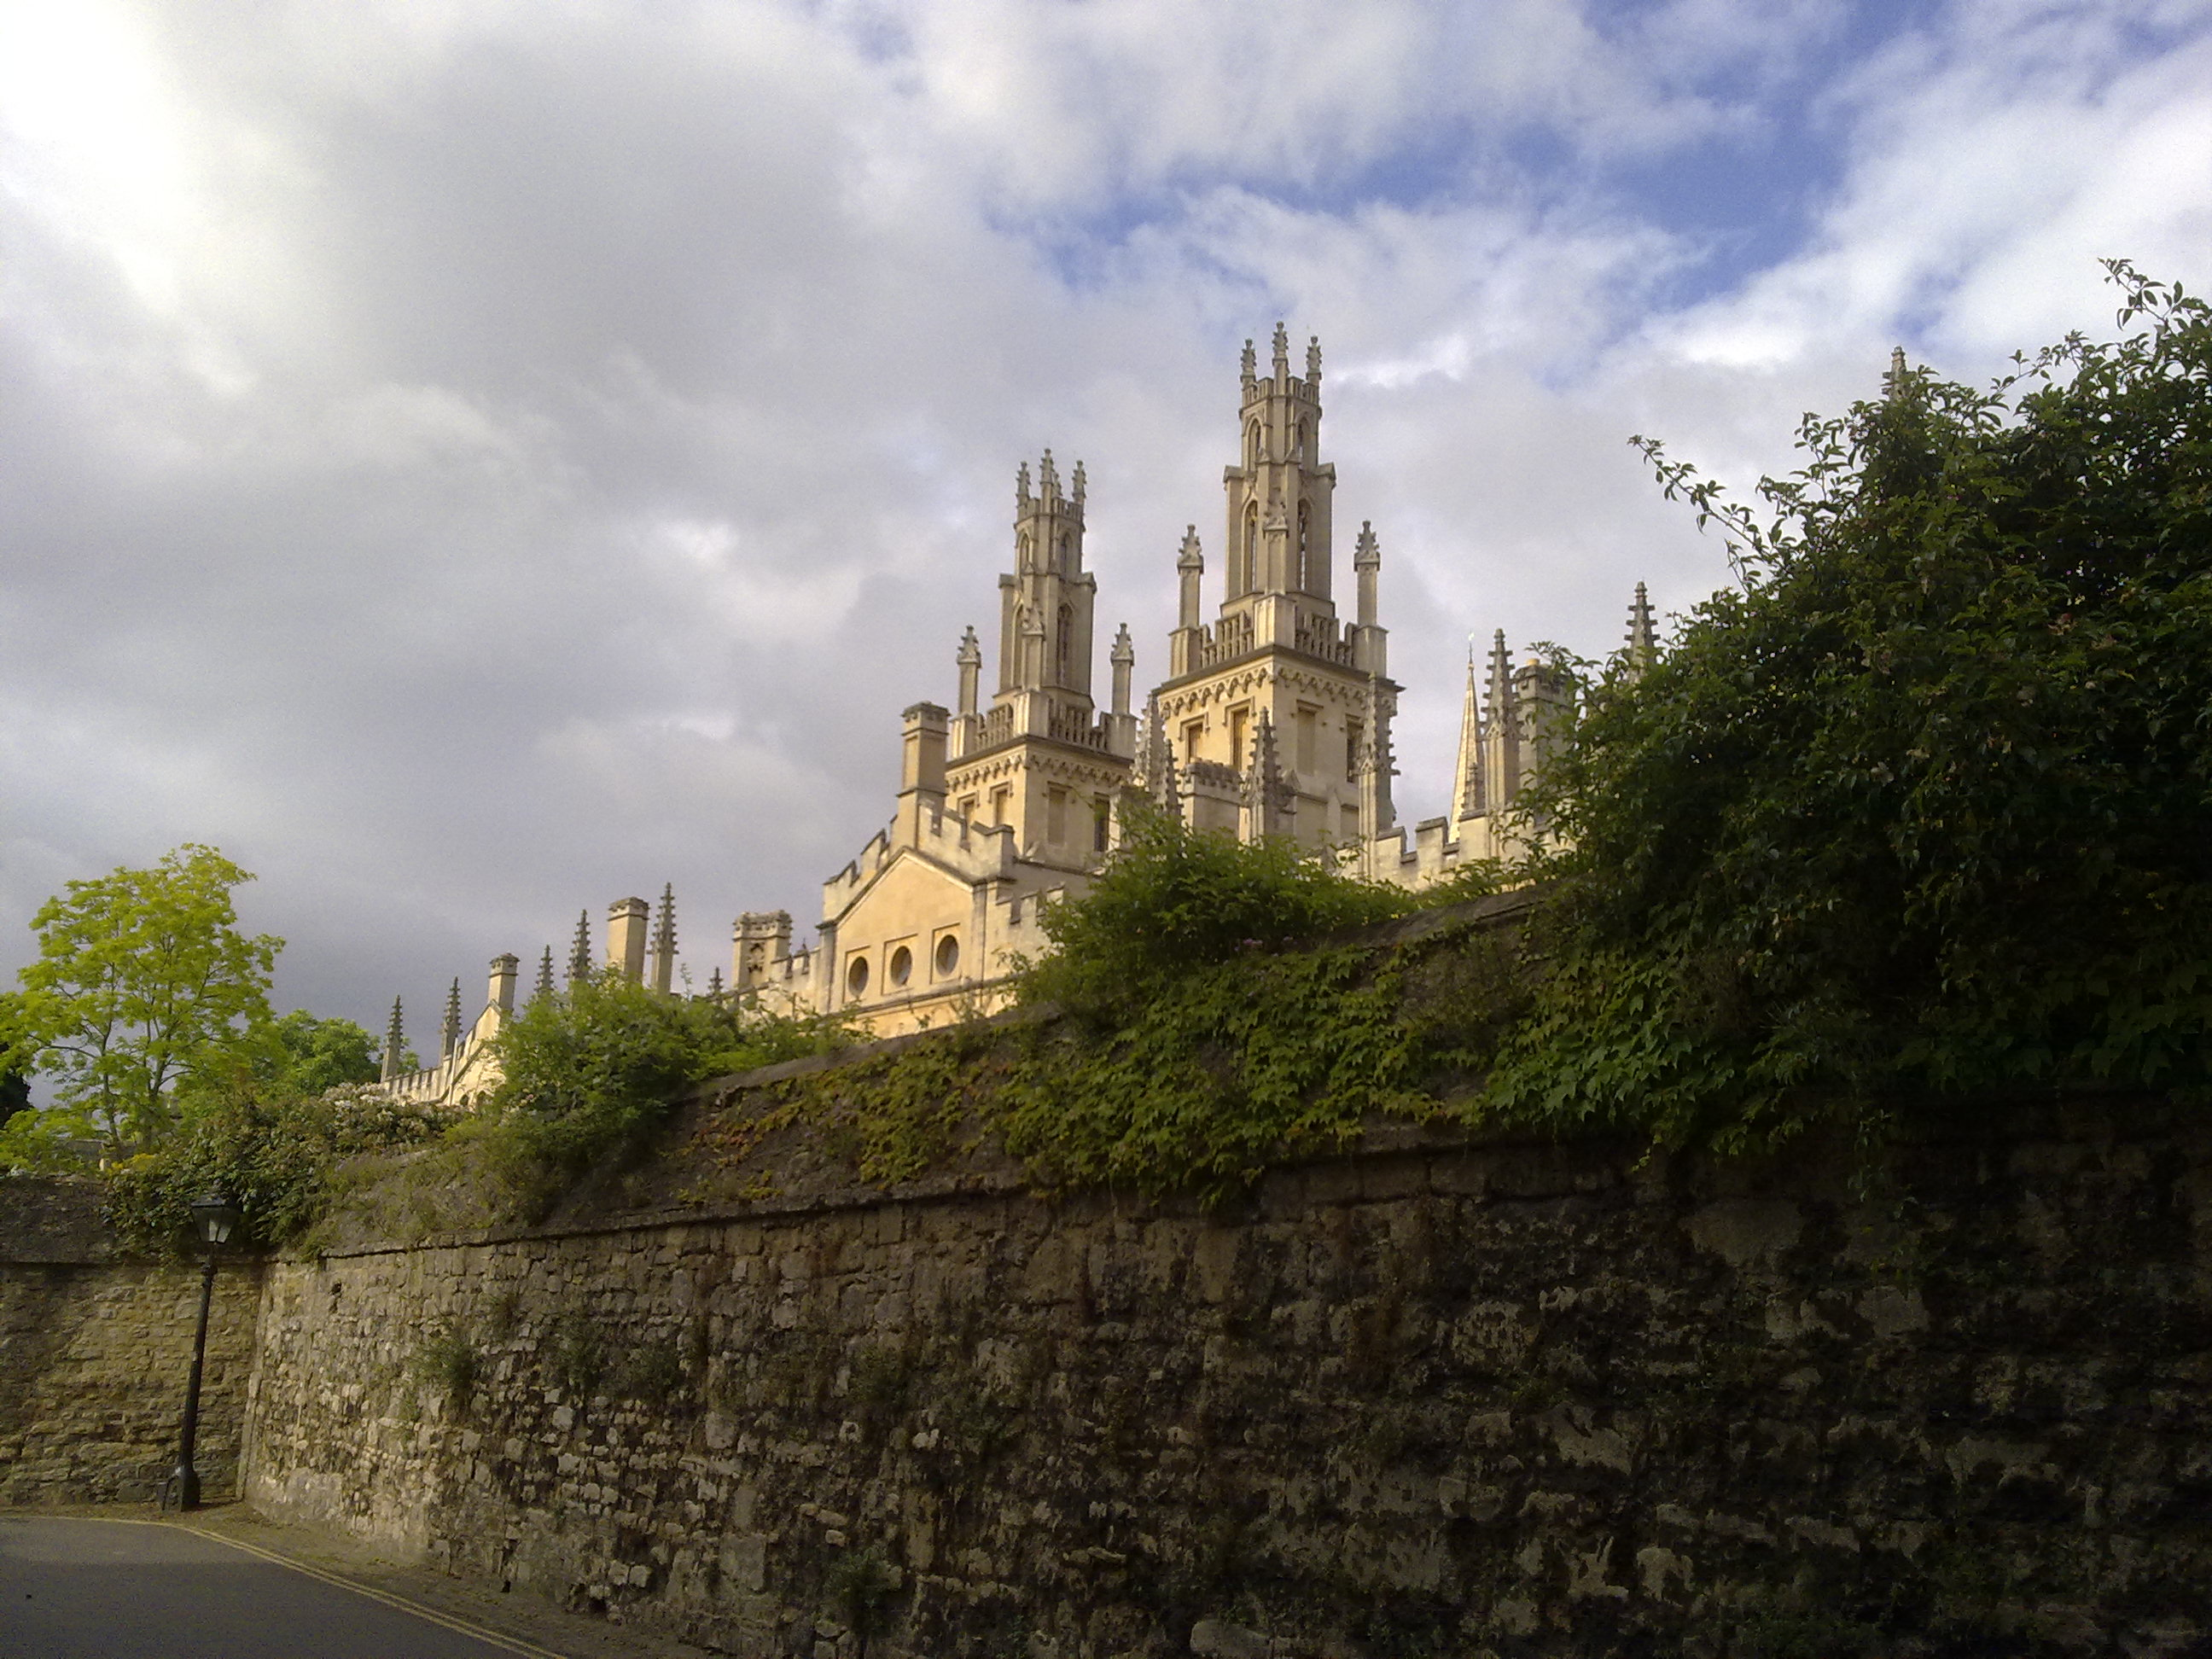
From the Ivory Tower…
Source: Wikipedia (All Souls College, Oxford)

Slide 4
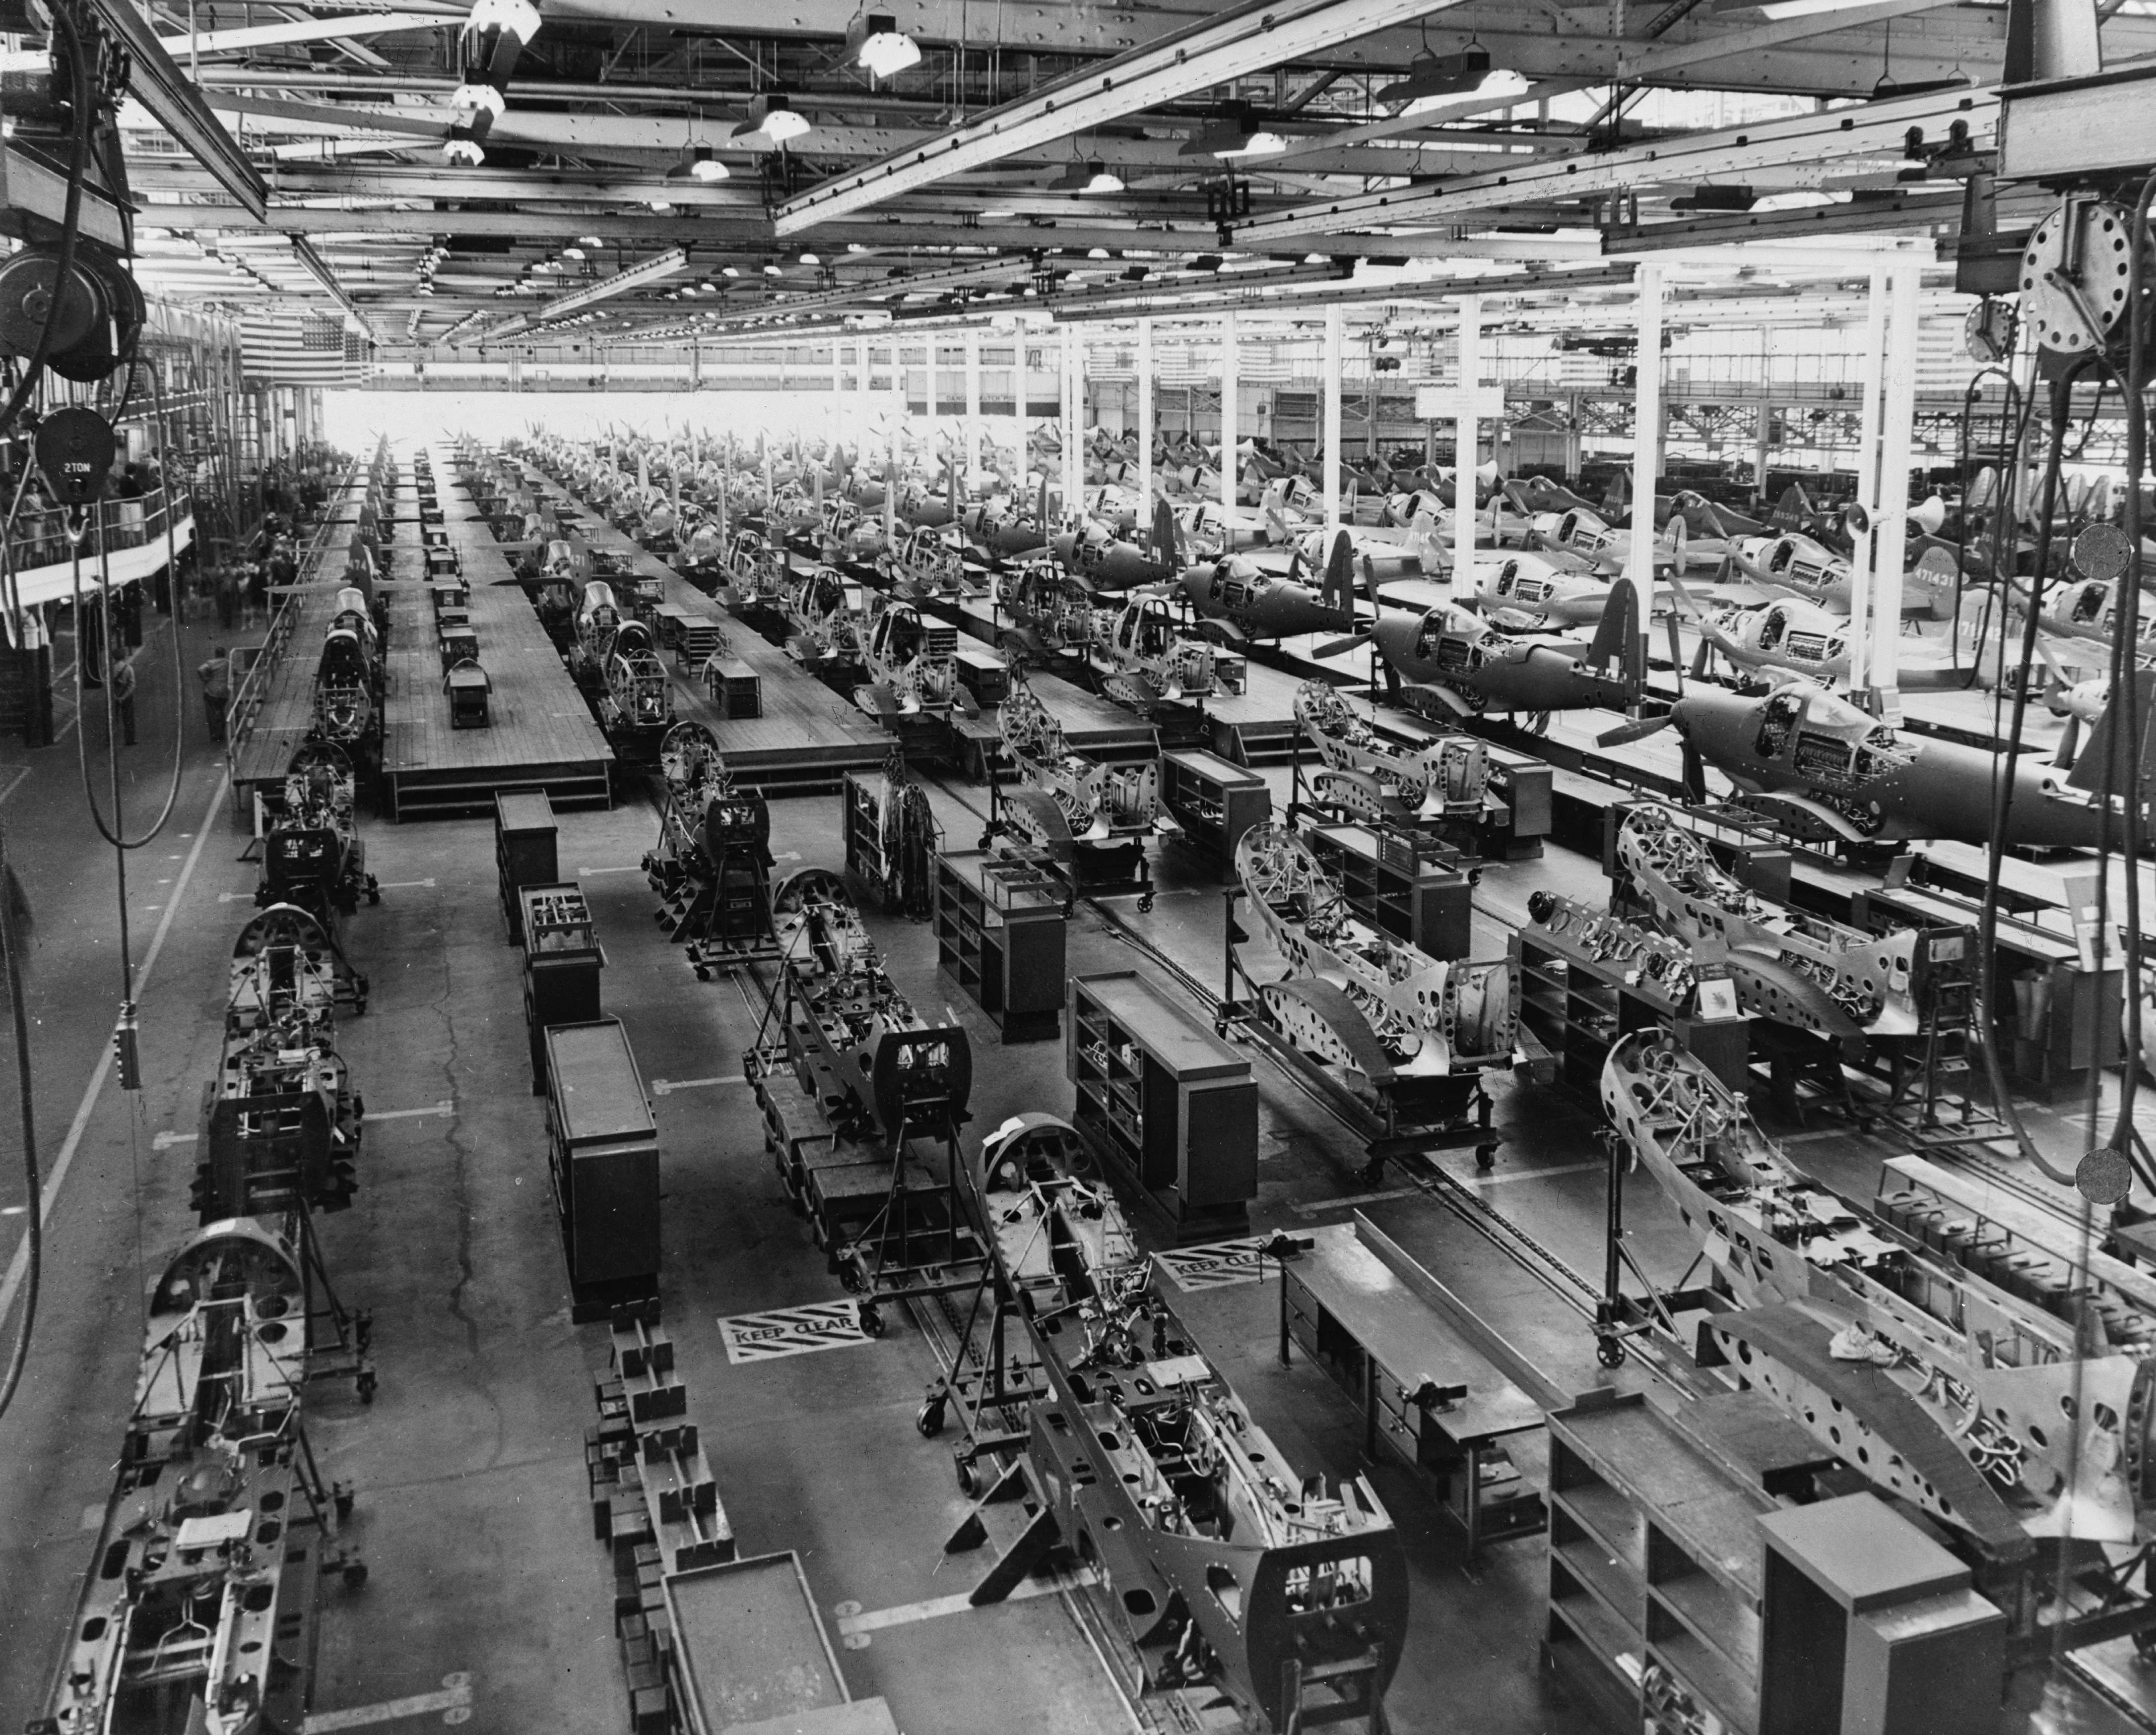

… to building sh*t that works
Source: Wikipedia (Factory)

Slide 5
… and back.
Source: Wikipedia (All Souls College, Oxford)

Slide 6
@lintool

Slide 7
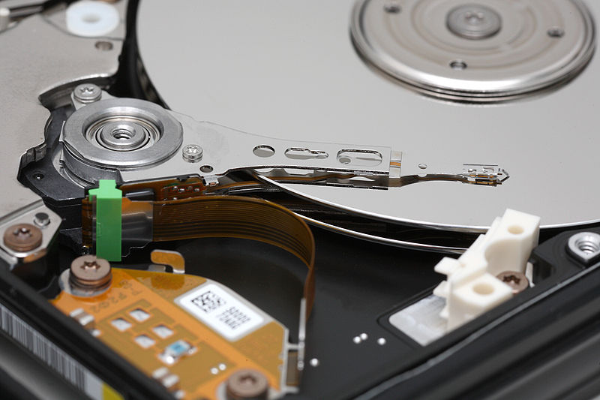
Big Data
Source: Wikipedia (Hard disk drive)

Slide 8







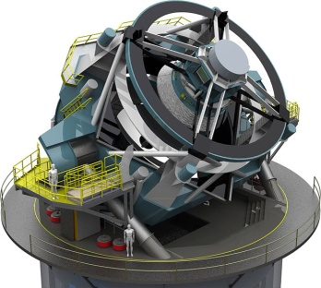
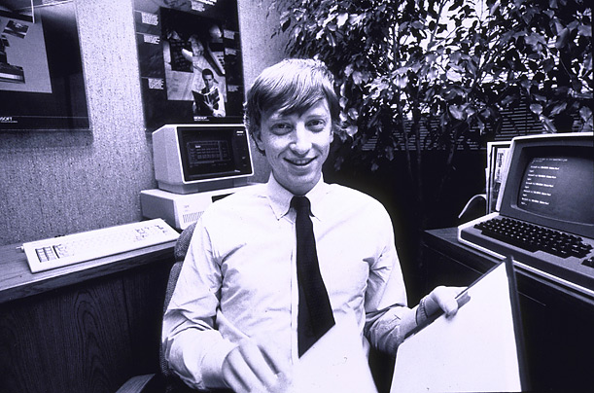
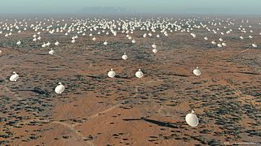
How much data?
processes 20 PB a day (2008)
crawls 20B web pages a day (2012)
150 PB on 50k+ servers running 15k apps (6/2011)
>10 PB data, 75B DB calls per day (6/2012)
Wayback Machine: 240B web pages archived, 5 PB (1/2013)
>100 PB of user data + 500 TB/day (8/2012)
LHC: ~15 PB a year
S3: 449B objects, peak 290k request/second (7/2011)
1T objects (6/2012)
640K ought to be enough for anybody.
LSST: 6-10 PB a year (~2015)
SKA: 0.3 – 1.5 EB per year (~2020)

Slide 9
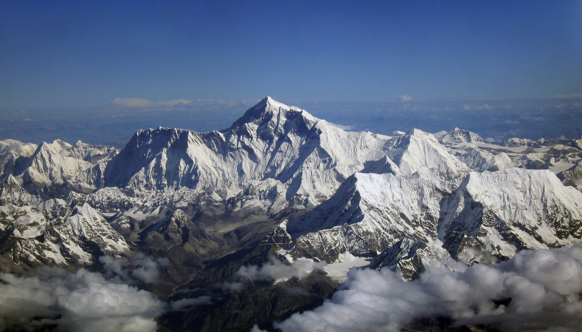
Why big data?
Science
Engineering
Commerce
Source: Wikipedia (Everest)

Slide 10
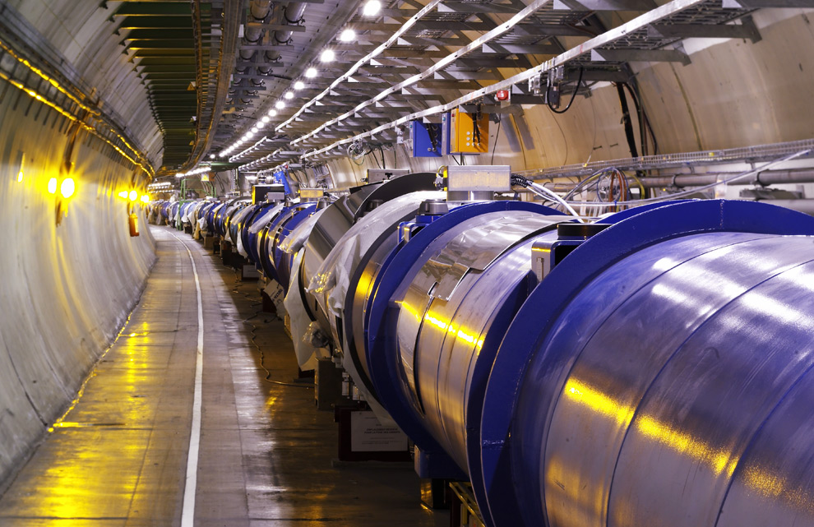
Science
Emergence of the 4th Paradigm
Data-intensive e-Science
Maximilien Brice, © CERN
Notes:
By the time it shuts down in 2011, the CERN collider should have amassed about 20 times as much data as it now has. (NYTimes article, “Trillions of Reasons to Be Excited”, 11/1/2010)

Slide 11
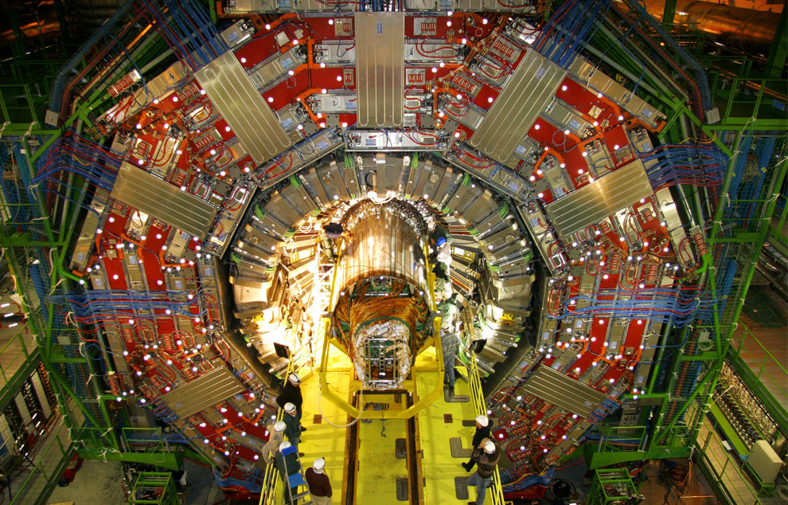
Maximilien Brice, © CERN

Slide 12
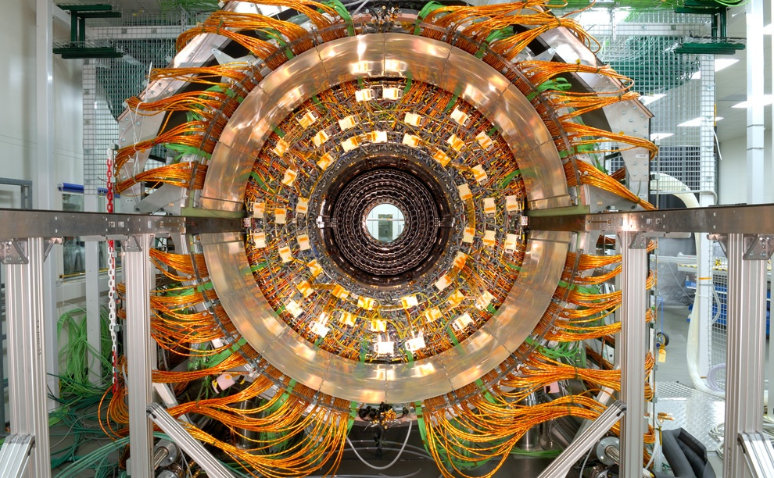
Maximilien Brice, © CERN

Slide 13
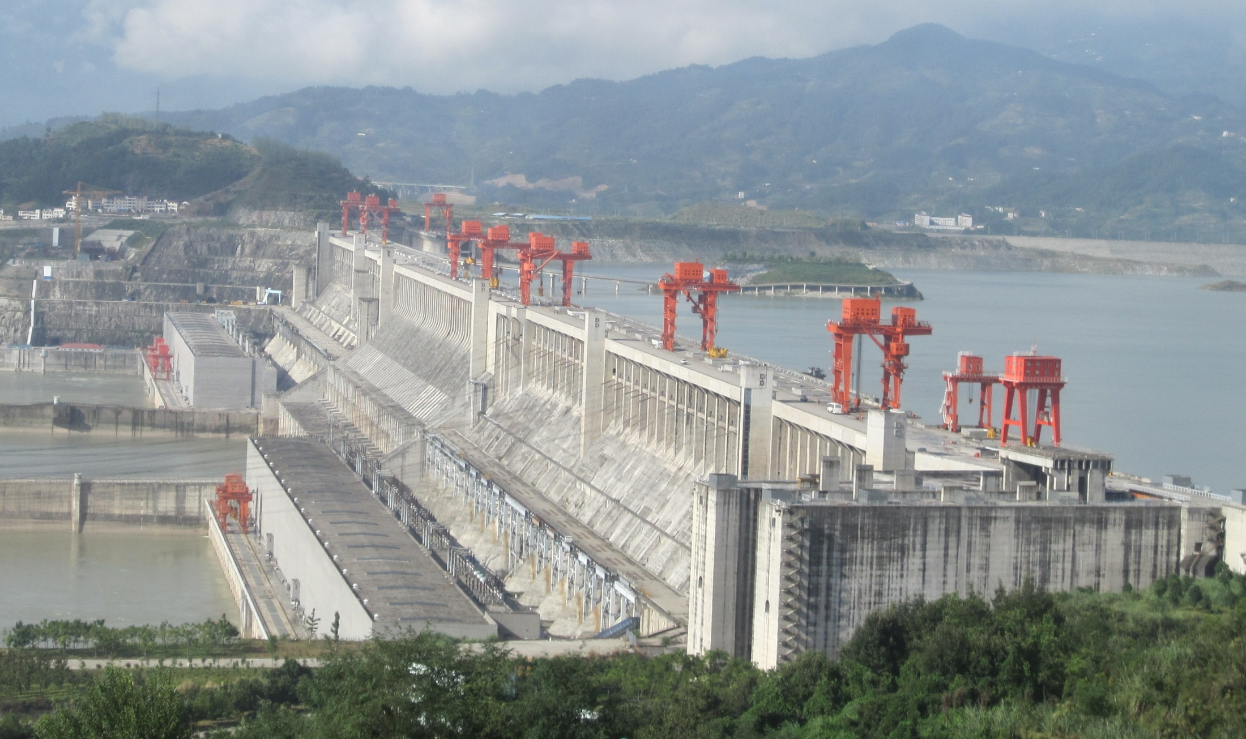
Engineering
The unreasonable effectiveness of data
Count and normalize!
Source: Wikipedia (Three Gorges Dam)

Slide 14
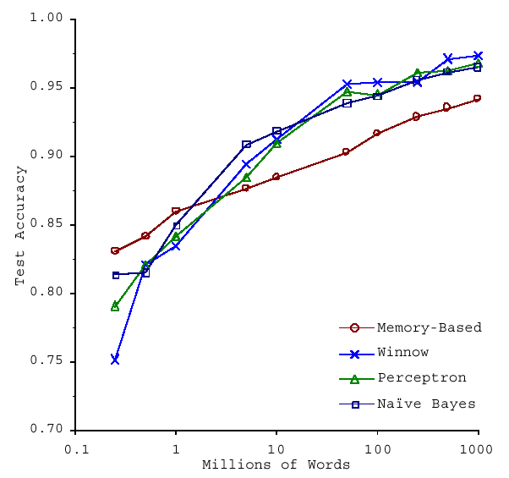
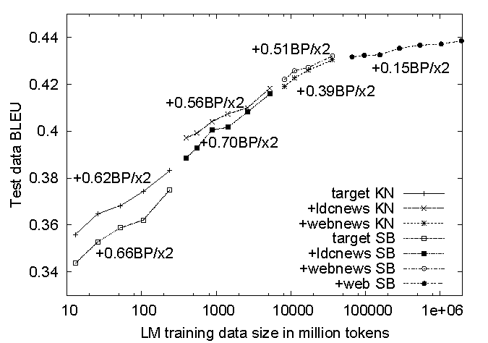
No data like more data!
s/knowledge/data/g;
(Banko and Brill, ACL 2001)
(Brants et al., EMNLP 2007)

Slide 15
What to do with more data?
Answering factoid questions
Pattern matching on the Web
Works amazingly well
Learning relations
Start with seed instances
Search for patterns on the Web
Using patterns to find more instances
Who shot Abraham Lincoln? → X shot Abraham Lincoln
Wolfgang Amadeus Mozart (1756 - 1791)
Einstein was born in 1879
Birthday-of(Mozart, 1756)
Birthday-of(Einstein, 1879)
PERSON (DATE –
PERSON was born in DATE
(Brill et al., TREC 2001; Lin, ACM TOIS 2007)
(Agichtein and Gravano, DL 2000; Ravichandran and Hovy, ACL 2002; … )

Slide 16

Know thy customers
Data → Insights → Competitive advantages
Commerce
Source: Wikiedia (Shinjuku, Tokyo)

Slide 17

Why big data?
How big data?
Source: Wikipedia (Noctilucent cloud)

Slide 18

Course Administrivia
Source: http://www.flickr.com/photos/artmind_etcetera/6336693594/

Slide 19
Course Pre-requisites (I)
Competent Java programming
But this course is not about programming
Focus on “thinking at scale” and algorithm design
You’re expected to pick up Hadoop with minimal help
Be good at debugging
Google it!

Slide 20
Course Pre-requisites (II)
Basic knowledge of
Probability and statistics, discrete math
Computer architecture
No previous experience necessary in
MapReduce
Parallel and distributed programming
Curiosity

Slide 21
How will I actually learn Hadoop?
Next class session
Hadoop: The Definitive Guide
RTFM
RTFC(!)

Slide 22
This course is not for you…
If you’re not genuinely interested in the topic
If you can’t put in the time
If you’re uncomfortable with uncertainty, unpredictability, etc. that comes with bleeding-edge software
Otherwise, this will be a rewarding and fun course!

Slide 23
Details, Details…
Make sure you’re on the mailing list!
Textbooks
Components of the final grade:
Assignments
Midterm
Final exam
Final project
I am unlikely to accept the following excuses:
“Too busy”
“It took longer than I thought it would take”
“It was harder than I initially thought”
“My dog ate my homework” and modern variants thereof

Slide 24
Hadoop Resources
Hadoop on your local machine
Hadoop in a virtual machine on your local machine
Hadoop on Amazon EC2

Slide 25

Be Prepared…
Source: Wikipedia (The Scream)

Slide 26
“Hadoop Zen”
This is bleeding-edge technology (= immature!)
We’ve come a long way since 2007, but still far to go…
Bugs, undocumented “features”, inexplicable behavior, data loss(!)
Don’t get frustrated (take a deep breath)…
Those W$*#T@F! moments
Be patient…
We will inevitably encounter “situations” along the way
Be flexible…
We will have to be creative in workarounds
Be constructive…
Tell me how I can make everyone’s experience better

Slide 27

“Hadoop Zen”
Source: Wikipedia (Japanese rock garden)

Slide 28

Interlude: Cloud Computing
Source: Wikipedia (Clouds)

Slide 29
The best thing since sliced bread?
Before clouds…
Grids
Connection machine
Vector supercomputers
…
Cloud computing means many different things:
Big data
Rebranding of web 2.0
Utility computing
Everything as a service

Slide 30
Rebranding of web 2.0
Rich, interactive web applications
Clouds refer to the servers that run them
AJAX as the de facto standard (for better or worse)
Examples: Facebook, YouTube, Gmail, …
“The network is the computer”: take two
User data is stored “in the clouds”
Rise of the netbook, smartphones, etc.
Browser is the OS

Slide 31
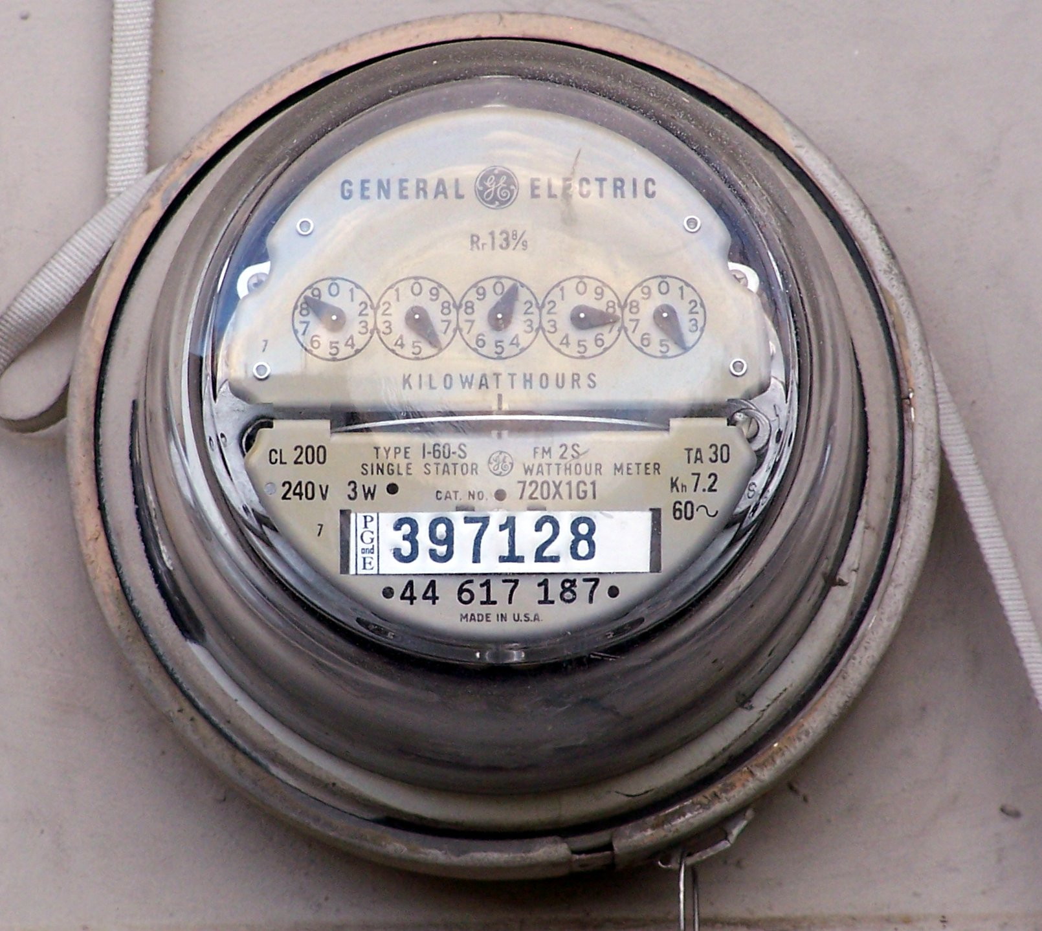
Source: Wikipedia (Electricity meter)

Slide 32
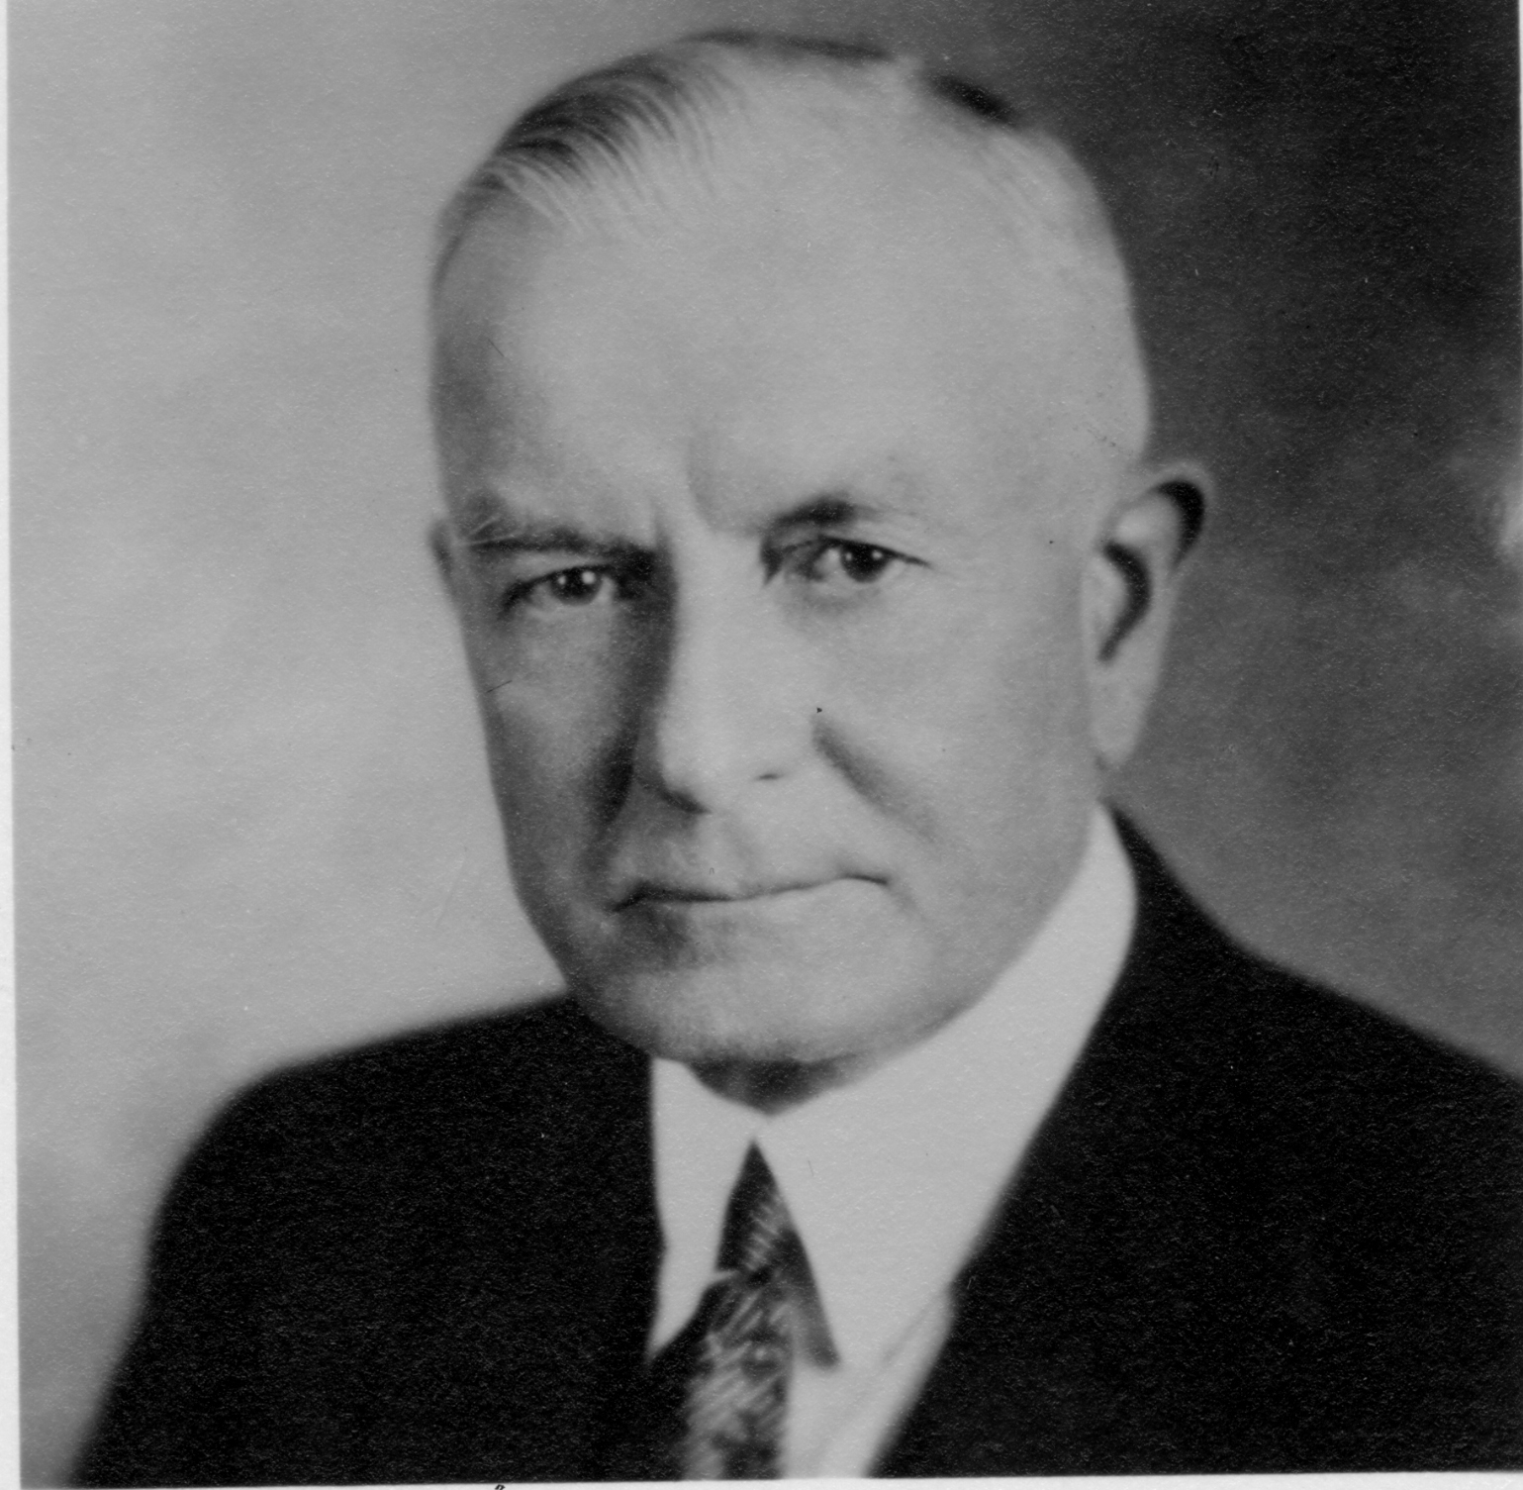
Utility Computing
What?
Computing resources as a metered service (“pay as you go”)
Ability to dynamically provision virtual machines
Why?
Cost: capital vs. operating expenses
Scalability: “infinite” capacity
Elasticity: scale up or down on demand
Does it make sense?
Benefits to cloud users
Business case for cloud providers
I think there is a world market for about five computers.

Slide 33
Enabling Technology: Virtualization
App
App
App
App
App
App
OS
OS
OS
Operating System
Hypervisor
Hardware
Hardware
Traditional Stack
Virtualized Stack

Slide 34
Everything as a Service
Utility computing = Infrastructure as a Service (IaaS)
Why buy machines when you can rent cycles?
Examples: Amazon’s EC2, Rackspace
Platform as a Service (PaaS)
Give me nice API and take care of the maintenance, upgrades, …
Example: Google App Engine
Software as a Service (SaaS)
Just run it for me!
Example: Gmail, Salesforce

Slide 35
Who cares?
Ready-made big data problems
Social media, user-generated content = big data
Examples: Facebook friend suggestions, Google ad placement
Business intelligence: gather everything in a data warehouse and run analytics to generate insight
Utility computing provides:
Ability to provision Hadoop clusters on-demand in the cloud
lower barrier to entry for tackling big data problems
Commoditization and democratization of big data capabilities

Slide 36
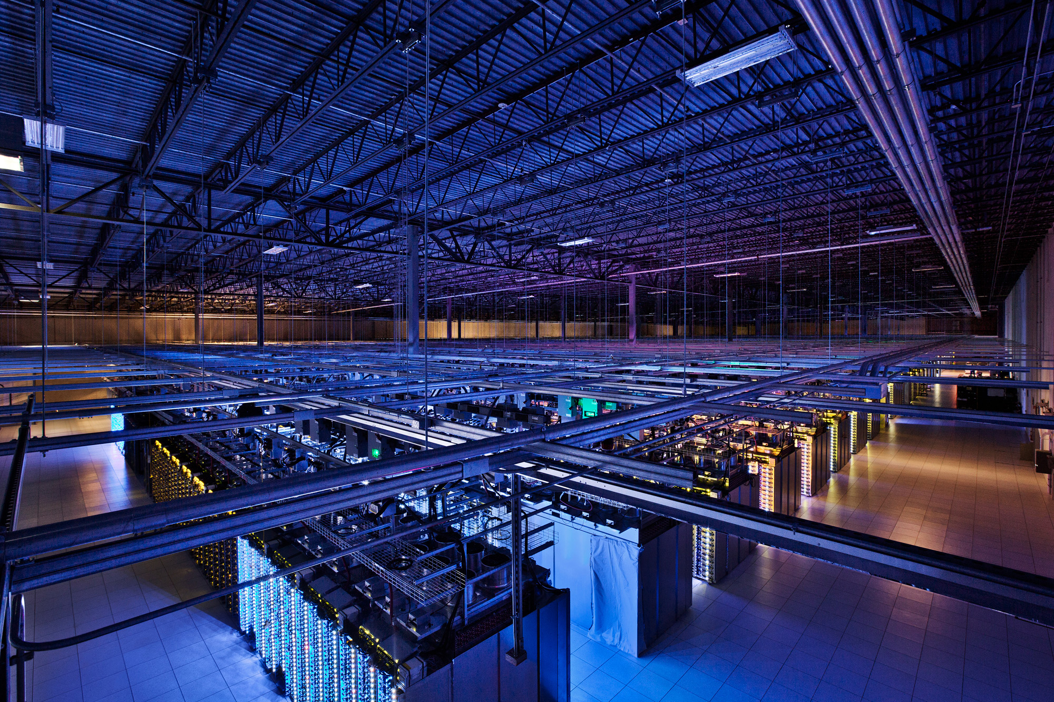
Tackling Big Data
Source: Google

Slide 37

Source: http://www.flickr.com/photos/22897666@N00/5711185410/

Slide 38
Divide and Conquer
“Work”
Partition
w₁
w₂
w₃
worker
worker
worker
r₁
r₂
r₃
Combine
“Result”

Slide 39
Parallelization Challenges
How do we assign work units to workers?
What if we have more work units than workers?
What if workers need to share partial results?
How do we aggregate partial results?
How do we know all the workers have finished?
What if workers die?
What’s the common theme of all of these problems?

Slide 40
Common Theme?
Parallelization problems arise from:
Communication between workers (e.g., to exchange state)
Access to shared resources (e.g., data)
Thus, we need a synchronization mechanism

Slide 41
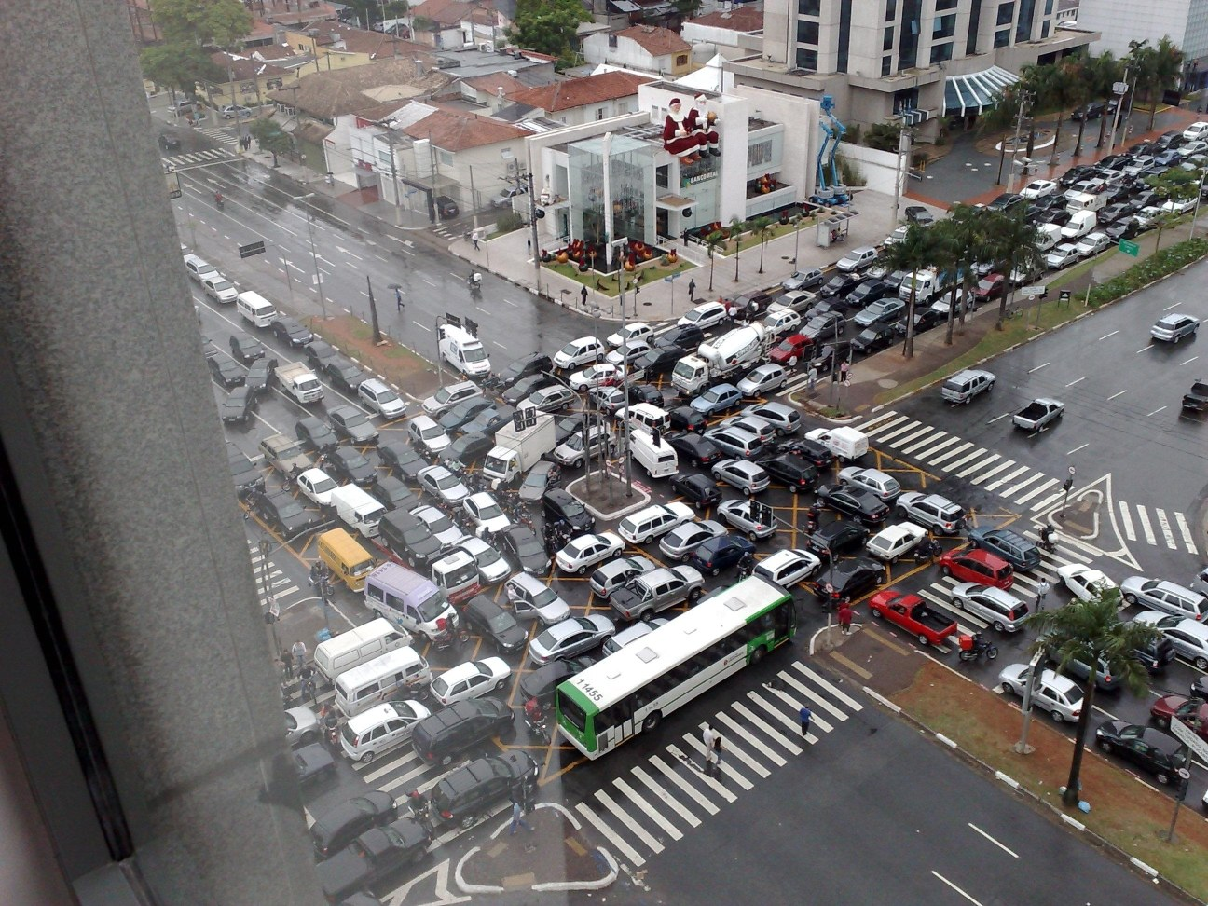
Source: Ricardo Guimarães Herrmann

Slide 42
Managing Multiple Workers
Difficult because
We don’t know the order in which workers run
We don’t know when workers interrupt each other
We don’t know when workers need to communicate partial results
We don’t know the order in which workers access shared data
Thus, we need:
Semaphores (lock, unlock)
Conditional variables (wait, notify, broadcast)
Barriers
Still, lots of problems:
Deadlock, livelock, race conditions...
Dining philosophers, sleeping barbers, cigarette smokers...
Moral of the story: be careful!

Slide 43
Current Tools
Shared Memory
Message Passing
Programming models
Shared memory (pthreads)
Message passing (MPI)
Design Patterns
Master-slaves
Producer-consumer flows
Shared work queues
Memory
P₁
P₂
P₃
P₄
P₅
P₁
P₂
P₃
P₄
P₅
producer
consumer
master
work queue
slaves
producer
consumer

Slide 44
Where the rubber meets the road
Concurrency is difficult to reason about
Concurrency is even more difficult to reason about
At the scale of datacenters and across datacenters
In the presence of failures
In terms of multiple interacting services
Not to mention debugging…
The reality:
Lots of one-off solutions, custom code
Write you own dedicated library, then program with it
Burden on the programmer to explicitly manage everything

Slide 45
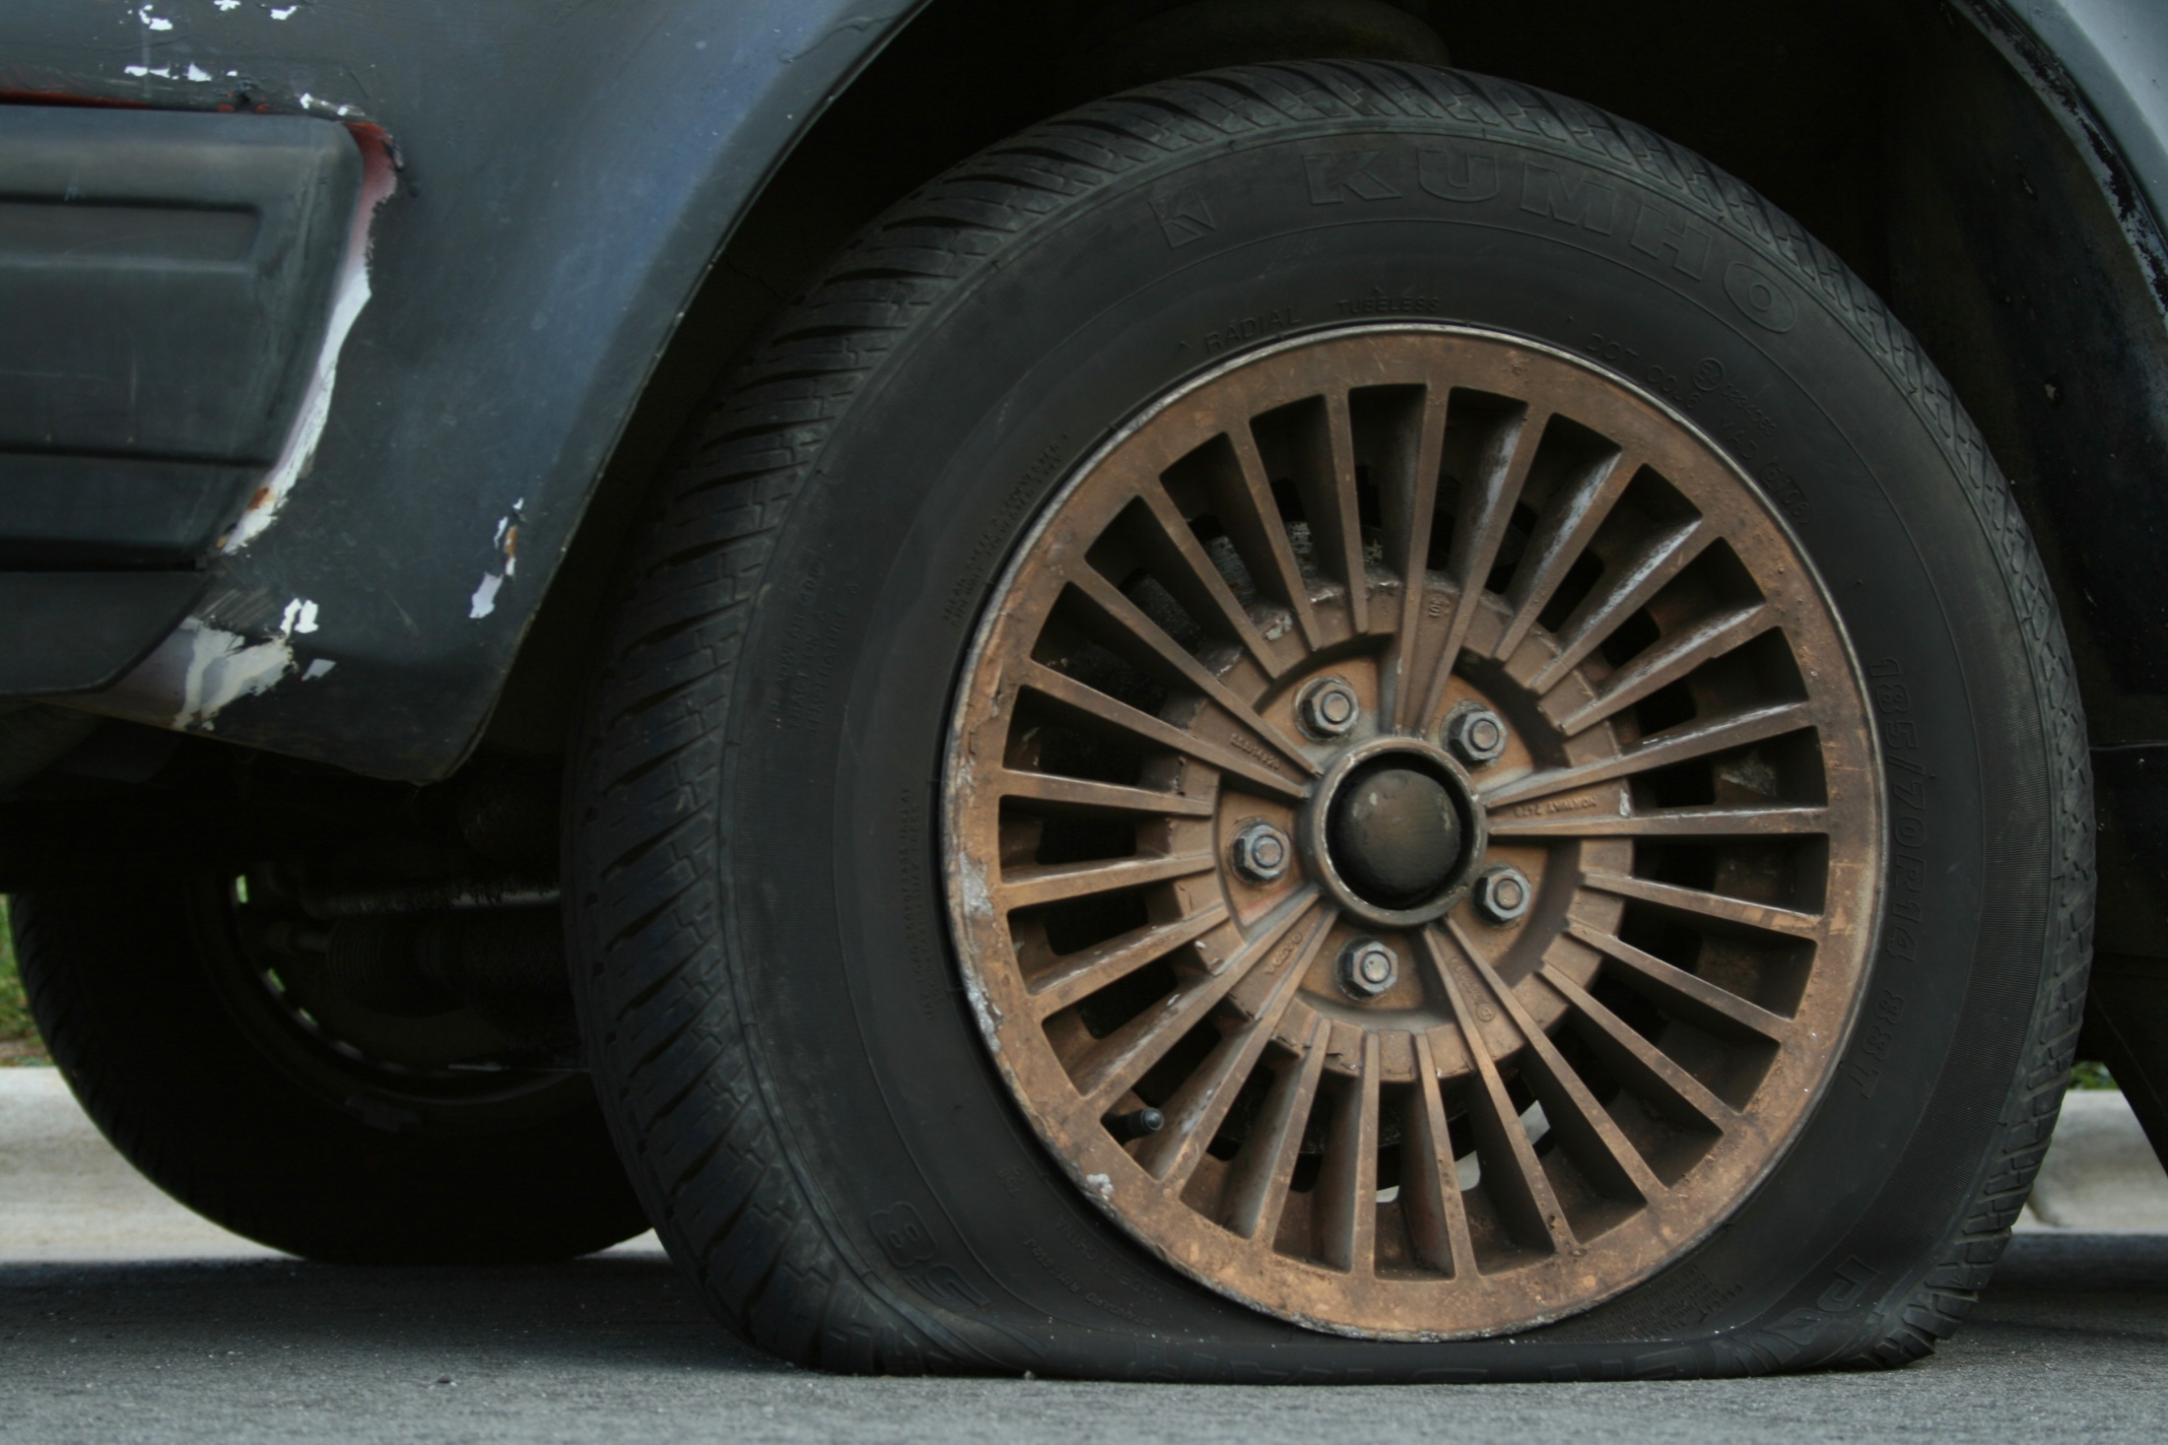
Source: Wikipedia (Flat Tire)

Slide 46
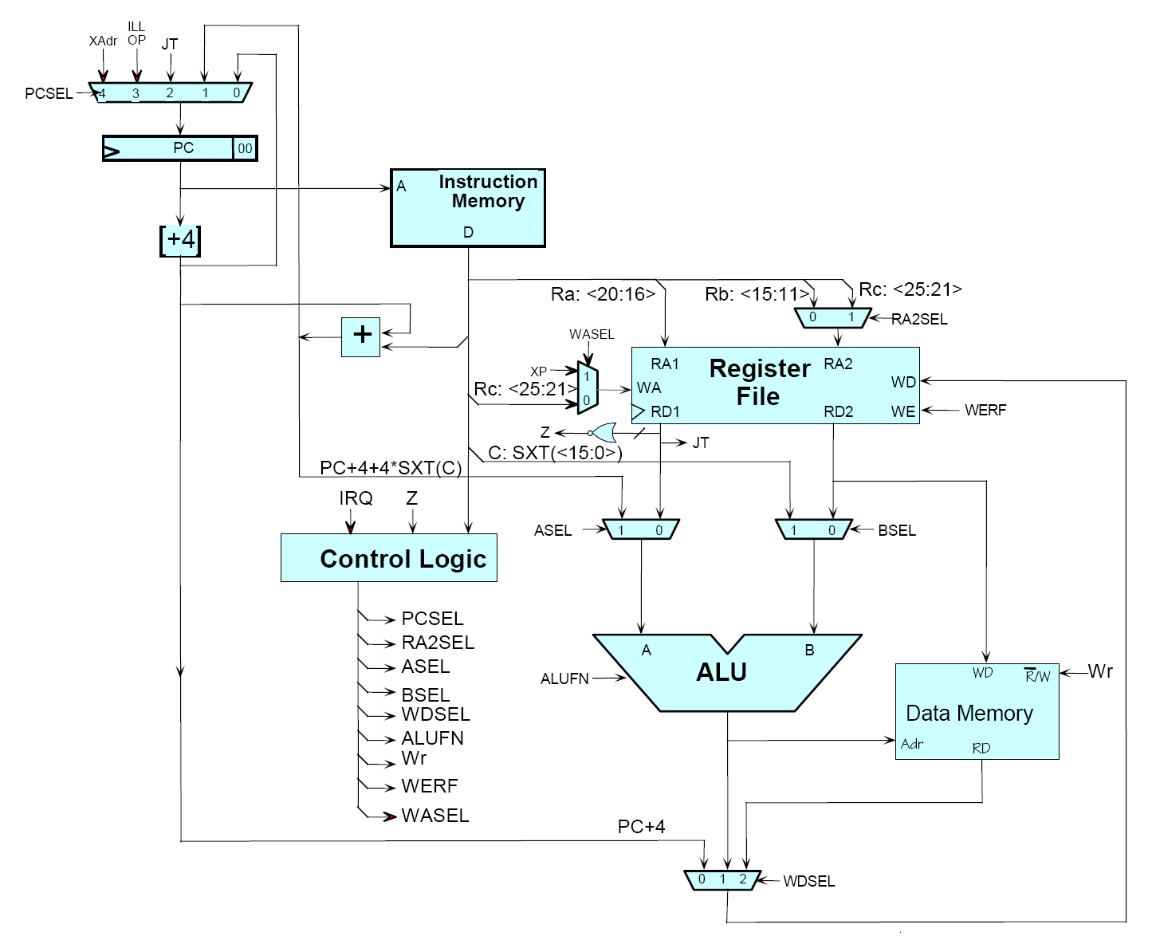
Source: MIT Open Courseware

Slide 47

Source: MIT Open Courseware

Slide 48
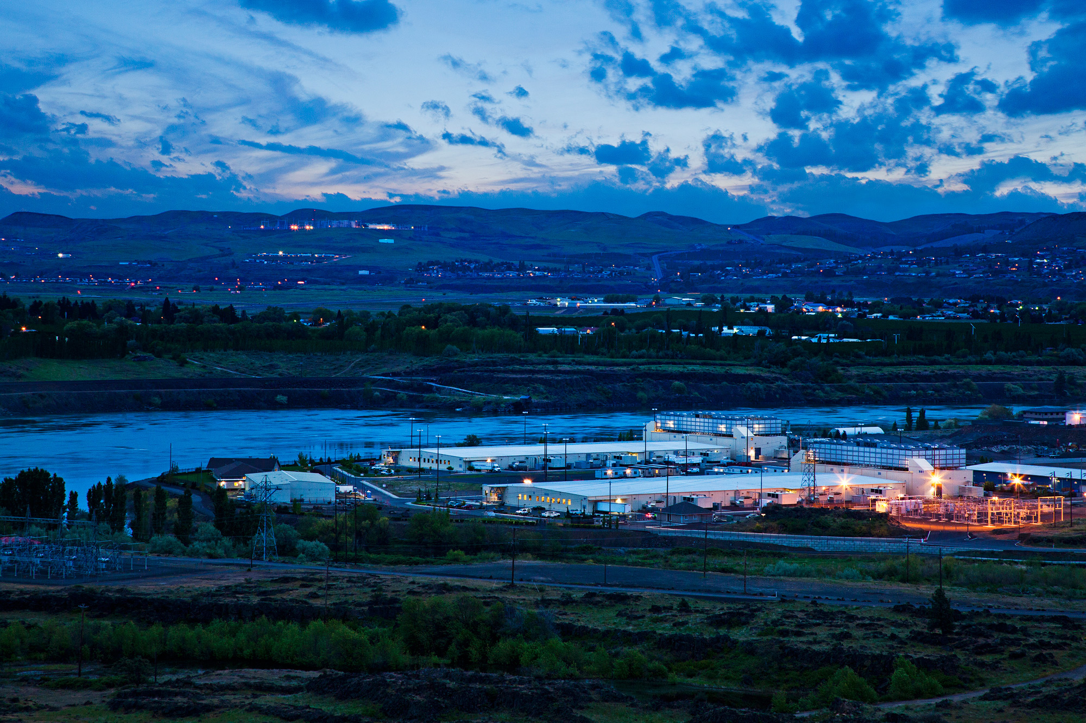
The datacenter is the computer!
Source: Google

Slide 49
What’s the point?
It’s all about the right level of abstraction
Moving beyond the von Neumann architecture
We need better programming models
Hide system-level details from the developers
No more race conditions, lock contention, etc.
Separating the what from how
Developer specifies the computation that needs to be performed
Execution framework (“runtime”) handles actual execution
The datacenter is the computer!

Slide 50
“Big Ideas”
Scale “out”, not “up”
Limits of SMP and large shared-memory machines
Move processing to the data
Cluster have limited bandwidth
Process data sequentially, avoid random access
Seeks are expensive, disk throughput is reasonable
Seamless scalability
From the mythical man-month to the tradable machine-hour

Slide 51
MapReduce
Source: Google

Slide 52
Typical Big Data Problem
Iterate over a large number of records
Extract something of interest from each
Shuffle and sort intermediate results
Aggregate intermediate results
Generate final output
Map
Reduce
Key idea: provide a functional abstraction for these two operations
(Dean and Ghemawat, OSDI 2004)

Slide 53
Roots in Functional Programming
Map
f
f
f
f
f
Fold
g
g
g
g
g

Slide 54
MapReduce
Programmers specify two functions:
map (k, v) → <k’, v’>*
reduce (k’, v’) → <k’, v’>*
All values with the same key are sent to the same reducer
The execution framework handles everything else…

Slide 55
k₁
v₁
k₂
v₂
k₃
v₃
k₄
v₄
k₅
v₅
k₆
v₆
map
map
map
map
a
1
b
2
c
3
c
6
a
5
c
2
b
7
c
8
Shuffle and Sort: aggregate values by keys
a
1
5
b
2
7
c
2
3
6
8
reduce
reduce
reduce
r₁
s₁
r₂
s₂
r₃
s₃

Slide 56
MapReduce
Programmers specify two functions:
map (k, v) → <k’, v’>*
reduce (k’, v’) → <k’, v’>*
All values with the same key are sent to the same reducer
The execution framework handles everything else…
What’s “everything else”?

Slide 57
MapReduce “Runtime”
Handles scheduling
Assigns workers to map and reduce tasks
Handles “data distribution”
Moves processes to data
Handles synchronization
Gathers, sorts, and shuffles intermediate data
Handles errors and faults
Detects worker failures and restarts
Everything happens on top of a distributed FS (later)

Slide 58
MapReduce
Programmers specify two functions:
map (k, v) → <k’, v’>*
reduce (k’, v’) → <k’, v’>*
All values with the same key are reduced together
The execution framework handles everything else…
Not quite…usually, programmers also specify:
partition (k’, number of partitions) → partition for k’
Often a simple hash of the key, e.g., hash(k’) mod n
Divides up key space for parallel reduce operations
combine (k’, v’) → <k’, v’>*
Mini-reducers that run in memory after the map phase
Used as an optimization to reduce network traffic

Slide 59
k₁
v₁
k₂
v₂
k₃
v₃
k₄
v₄
k₅
v₅
k₆
v₆
map
map
map
map
a
1
b
2
c
3
c
6
a
5
c
2
b
7
c
8
combine
combine
combine
combine
a
1
b
2
c
9
a
5
c
2
b
7
c
8
partition
partition
partition
partition
Shuffle and Sort: aggregate values by keys
a
1
5
b
2
7
c
c
2
2
9
3
8
6
8
reduce
reduce
reduce
r₁
s₁
r₂
s₂
r₃
s₃

Slide 60
Two more details…
Barrier between map and reduce phases
But we can begin copying intermediate data earlier
Keys arrive at each reducer in sorted order
No enforced ordering across reducers

Slide 61
“Hello World”: Word Count
Map(String docid, String text):
for each word w in text:
Emit(w, 1);
Reduce(String term, Iterator<Int> values):
int sum = 0;
for each v in values:
sum += v;
Emit(term, value);

Slide 62
MapReduce can refer to…
The programming model
The execution framework (aka “runtime”)
The specific implementation
Usage is usually clear from context!

Slide 63

MapReduce Implementations
Google has a proprietary implementation in C++
Bindings in Java, Python
Hadoop is an open-source implementation in Java
Development led by Yahoo, now an Apache project
Used in production at Yahoo, Facebook, Twitter, LinkedIn, Netflix, …
The de facto big data processing platform
Rapidly expanding software ecosystem
Lots of custom research implementations
For GPUs, cell processors, etc.

Slide 64
User Program
(1) submit
Master
(2) schedule map
(2) schedule reduce
worker
split 0
(6) write
output
file 0
split 1
(5) remote read
worker
split 2
(3) read
(4) local write
split 3
worker
split 4
worker
output
file 1
worker
Input
files
Map
phase
Intermediate files
(on local disk)
Reduce
phase
Output
files
Adapted from (Dean and Ghemawat, OSDI 2004)

Slide 65

How do we get data to the workers?
NAS
SAN
Compute Nodes
What’s the problem here?*
* Really a problem?

Slide 66
Distributed File System
Don’t move data to workers… move workers to the data!
Store data on the local disks of nodes in the cluster
Start up the workers on the node that has the data local
Why?
Not enough RAM to hold all the data in memory
Disk access is slow, but disk throughput is reasonable
A distributed file system is the answer
GFS (Google File System) for Google’s MapReduce
HDFS (Hadoop Distributed File System) for Hadoop

Slide 67
GFS: Assumptions
Commodity hardware over “exotic” hardware
Scale “out”, not “up”
High component failure rates
Inexpensive commodity components fail all the time
“Modest” number of huge files
Multi-gigabyte files are common, if not encouraged
Files are write-once, mostly appended to
Perhaps concurrently
Large streaming reads over random access
High sustained throughput over low latency
GFS slides adapted from material by (Ghemawat et al., SOSP 2003)

Slide 68
GFS: Design Decisions
Files stored as chunks
Fixed size (64MB)
Reliability through replication
Each chunk replicated across 3+ chunkservers
Single master to coordinate access, keep metadata
Simple centralized management
No data caching
Little benefit due to large datasets, streaming reads
Simplify the API
Push some of the issues onto the client (e.g., data layout)
HDFS = GFS clone (same basic ideas)

Slide 69
From GFS to HDFS
Terminology differences:
GFS master = Hadoop namenode
GFS chunkservers = Hadoop datanodes
Differences:
Different consistency model for file appends
Implementation
Performance
For the most part, we’ll use Hadoop terminology…

Slide 70
HDFS Architecture
HDFS namenode
Application
/foo/bar
(file name, block id)
File namespace
HDFS Client
block 3df2
(block id, block location)
instructions to datanode
(block id, byte range)
datanode state
HDFS datanode
HDFS datanode
block data
Linux file system
Linux file system
…
…
Adapted from (Ghemawat et al., SOSP 2003)

Slide 71
Namenode Responsibilities
Managing the file system namespace:
Holds file/directory structure, metadata, file-to-block mapping, access permissions, etc.
Coordinating file operations:
Directs clients to datanodes for reads and writes
No data is moved through the namenode
Maintaining overall health:
Periodic communication with the datanodes
Block re-replication and rebalancing
Garbage collection

Slide 72
Putting everything together…
namenode
job submission node
namenode daemon
jobtracker
tasktracker
tasktracker
tasktracker
datanode daemon
datanode daemon
datanode daemon
Linux file system
Linux file system
Linux file system
…
…
…
slave node
slave node
slave node
(Not Quite… We’ll come back to YARN later)

Slide 73
Questions?
Source: Wikipedia (Japanese rock garden)

